Slide 1
Converting fractions with technology
Comparing and ordering fractions and decimals (positive and negative)

Slide 2
how to use Oak lessons

Slide 3
I can convert from fractions to decimals and back again using the converter key on a calculator.

Slide 4



A proper fraction is a fraction where the numerator is less than the denominator.
Example
An improper fraction is a fraction where the numerator is greater than or equal to the denominator.
Example
A mixed number is an improper fraction written as its integer part plus the fractional part, where the fractional part is a proper fraction.
Example

Slide 5

Converting fractions with technology
Using a calculator to simplify fractions
Convert between fractions and decimals
Mixed numbers on a calculator

Slide 6
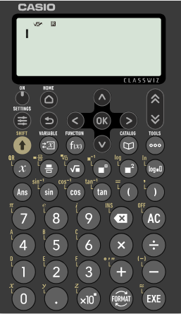
Using a calculator to simplify fractions
Scientific calculators are fantastic tools.
The Casio fx 991 classwiz can do so much, including simplifying fractions effortlessly.

Slide 7
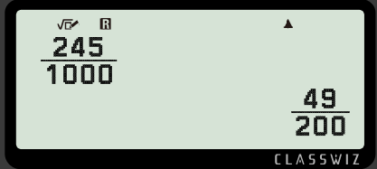
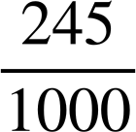
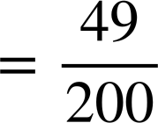


Using a calculator to simplify fractions
Scientific calculators are fantastic tools.
For example,
let’s simplify
Press 245
1000

Slide 8
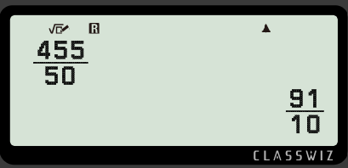
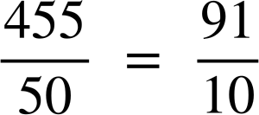
Using a calculator to simplify fractions
Scientific calculators are fantastic tools.
For example,
let’s simplify
Press 455
50

Slide 9
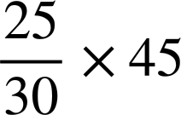
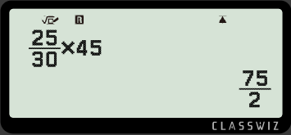
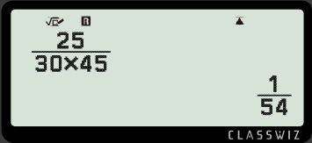

Using a calculator to simplify fractions
Sam wants to work out
Sam gets this on the calculator.
Sam should have pressed
What did Sam do wrong?
Sam needed to press to exit the denominator.

Slide 10
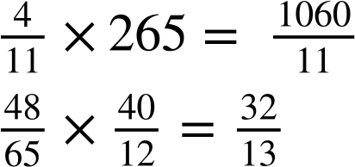

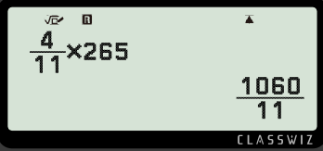
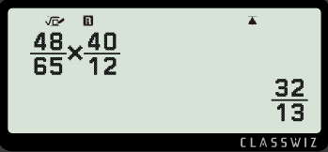
Using a calculator to simplify fractions
Using a calculator, work out the answers to the following, giving your answer as an improper fraction.
Using a calculator, work out the answers to the following, giving your answer as an improper fraction.

Slide 11
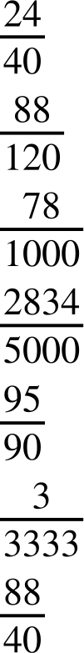
Using a calculator to simplify fractions
Using your calculator, write the simplified fractions to:
a)
b)
c)
d)
e)
f)

Slide 12
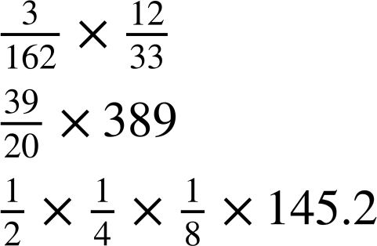
Using a calculator to simplify fractions
2) Using a calculator, work out the answers to the following giving your answer as a proper or improper fraction.
a)
b)

Slide 13
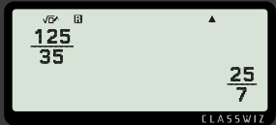
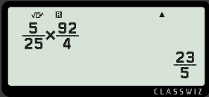
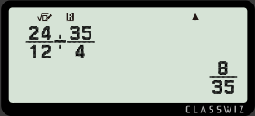
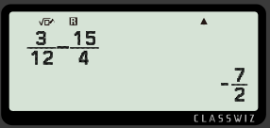
Using a calculator to simplify fractions
3) Figure out the missing digits on the calculator screen to make the calculation correct.
a)
b)
c)
d)

Slide 14
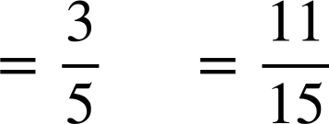
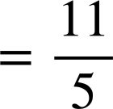
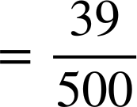
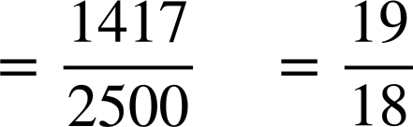
Using a calculator to simplify fractions
Using your calculator, write the simplified fractions to:
a)
b)
c)
d)
e)
f)

Slide 15
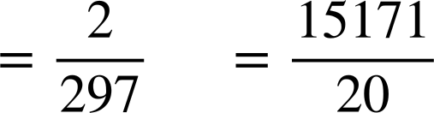
Using a calculator to simplify fractions
2) Using a calculator, work out the answers to the following giving your answer as a proper or improper fraction.
a)
b)

Slide 16
Using a calculator to simplify fractions
3) Figure out the missing digits on the calculator screen to make the calculation correct.
a)
b)
c)
d)

Slide 17
Converting fractions with technology
Using a calculator to simplify fractions
Convert between fractions and decimals
Mixed numbers on a calculator

Slide 18

Convert between fractions and decimals
Converting from fractions to decimals is easy with the Casio fx 991 classwiz.
For example, let’s input
the fraction and
convert it into decimal
form.

Slide 19
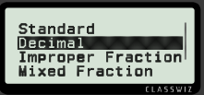
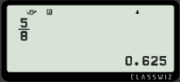
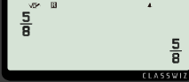



Convert between fractions and decimals
The Casio fx 991 classwiz allows you to change the format of a number.
Press
5
8
To convert to a decimal

Slide 20
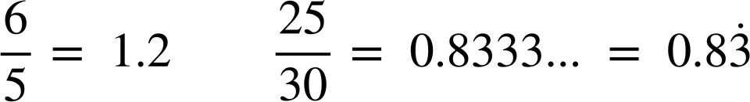
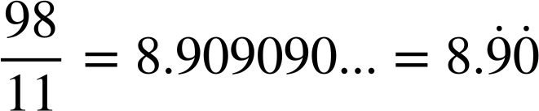
Convert between fractions and decimals
Using a calculator, work out the equivalent decimals for these fractions.
a)
c)
b)

Slide 21
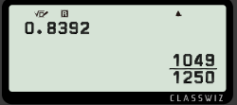

Convert between fractions and decimals
The Casio fx 991 classwiz allows you to change a terminating decimal into a fraction easily.
How do you think we change 0.8392 into a fraction?
Insert 0.8392 into the calculator and press
If it doesn’t convert it immediately, press
Select ‘Standard’

Slide 22
Convert between fractions and decimals
Using a calculator, match the decimal to the fraction.

Slide 23
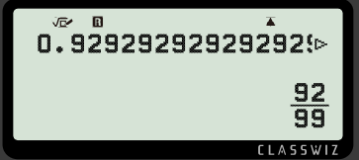
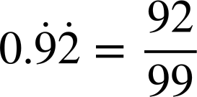
Convert between fractions and decimals
Converting recurring decimals into fractions takes a little more inputting.
We need to insert at least 18 decimal places when the number is less than 1.
For example
Write the equivalent fraction to the recurring decimal. 0.92929292….

Slide 24
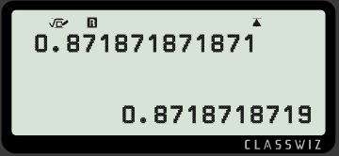
Convert between fractions and decimals
Aisha needed to find the fractional equivalent to
0.871871871…
She put this into her calculator.
Why did the calculator not give the decimal as a fraction?
Why is the last digit a 9?
She did not put in enough decimal places for the calculator to recognise it is a recurring decimal.
The calculator has rounded the decimal to 10 decimal places.

Slide 25

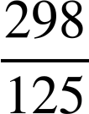

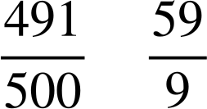
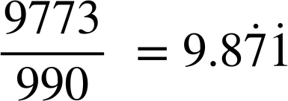
Convert between fractions and decimals
Using your calculator, fill in the table below.
Decimal | Simplified fraction

Slide 26
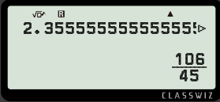
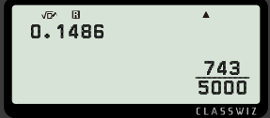
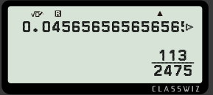
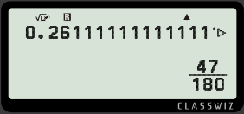
Convert between fractions and decimals
2) Find the missing values on the calculator displays.
a)
b)
c)
d)

Slide 27



Convert between fractions and decimals
Using your calculator, fill in the table below.
Decimal | Simplified fraction

Slide 28
Convert between fractions and decimals
2) Find the missing values on the calculator displays.
a)
b)
c)
d)

Slide 29
Converting fractions with technology
Using a calculator to simplify fractions
Convert between fractions and decimals
Mixed numbers on a calculator

Slide 30
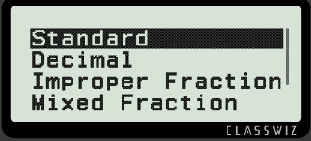
Mixed numbers on a calculator
The Casio fx 991 classwiz allows you to change the format of an answer too.
When an answer is found, pressing the
allows you to change how you want to see your answer.

Slide 31

Mixed numbers on a calculator
The Casio fx 991 classwiz allows you to change the format of an answer too.
For example,
Let’s change the improper
fraction
into a mixed
number.
Press
25
3

Slide 32
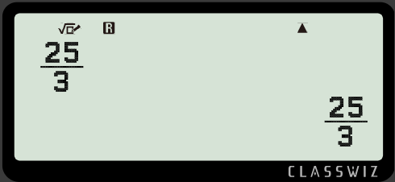
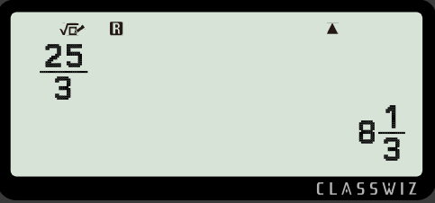
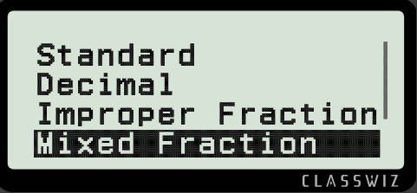
Mixed numbers on a calculator
The Casio fx 991 classwiz allows you to change the format of an answer too.
To convert to a mixed number,
press
Scroll down using
and press

Slide 33
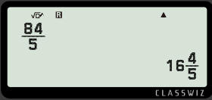

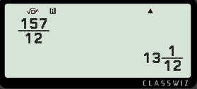
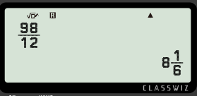
Mixed numbers on a calculator
Convert the following improper fractions to mixed numbers.
a)
b)
c)

Slide 34
Mixed numbers on a calculator
The Casio fx 991 classwiz allows you to change the format of an answer too.
Now let’s change a mixed number into a decimal and improper fraction.

Slide 35
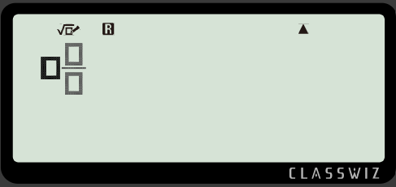


Mixed numbers on a calculator
The Casio fx 991 classwiz allows you to change the format of an answer too.
The mixed number button is accessed by pressing
SHIFT
then
You can then insert the integer and proper fraction.

Slide 36
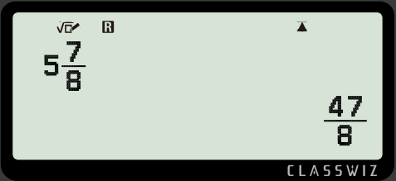
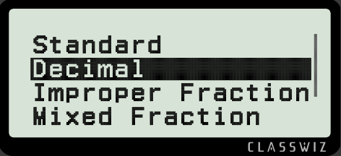
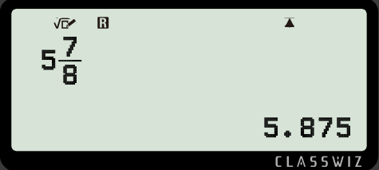


Mixed numbers on a calculator
We can convert the mixed number into a decimal.
For example,
Convert
into a decimal.
SHIFT
Press
Press
and select ‘decimal’.

Slide 37



Mixed numbers on a calculator
Fill in the table below.
Mixed number | Improper fraction | Decimal

Slide 38


Mixed numbers on a calculator
2) Work out the following calculations using your calculator. Give your answer as a mixed number.
a)
b)
c)
d) Create your own calculations where the answer is

Slide 39

Mixed numbers on a calculator
Fill in the table below.
Mixed number | Improper fraction | Decimal
24.375
4.2222222…
2.631578947

Slide 40
Mixed numbers on a calculator
2) Work out the following calculations using your calculator. Give your answer as a mixed number.
a)
b)
c)
d) Create your own calculations where the answer is

Slide 41

Converting fractions with technology
Scientific calculators are excellent tools and allow us to
successfully and easily convert between fractions and
decimals
using
the
button.

Slide 42

© Oak National Academy 2023.
Produced in partnership with Mathematics in Education and Industry.
Licensed on the Open Government Licence v3.0, except where otherwise stated. See Oak terms and conditions.

